Slide 1
Part D: agile practices
1: Meetings
2: Development
3: Release
4: Testing and quality
5: Management and others

Slide 2
Daily meeting
XP
Scrum
Held every morning
Goal: set the day’s work, in the broader context of the project
Time-limited, usually 15 minutes (“stand-up meeting”)
Involves all team members, with special role for “committed” (over just “involved”)
Focus:
Defining commitments
Uncovering impediments
Resolution will take place outside of meeting

Slide 3
Daily meeting: the three questions
The daily meeting requires every team member to answer three questions:
What did you do yesterday?
What will you do today?
Are there any impediments in your way?

Slide 4
Planning meeting
Scrum
At beginning of every sprint
Goal: define work for sprint
Outcome: Sprint Backlog, with time estimate for every task
8-hour time limit
1st half, product owner + team: prioritize product backlog
2nd half, team only: plan for Sprint, producing sprint backlog

Slide 5
Retrospective
Scrum
All team members reflect on past sprint
Make continuous process improvements
Two main questions:
What went well?
What could be improved?
3-hour time limit

Slide 6
Review meeting
Scrum
Review work:
Completed
Not completed
Present and demo completed work to stakeholders
Incomplete work cannot be demonstrated
4-hour time limit

Slide 7
Reflective improvement
Crystal
Developers must take breaks from regular development to look for ways to improve the process
Iterations help with this by providing feedback on whether or not the current process is working

Slide 8
Part D: Practices 1: Meetings
What we have seen: Agile development is characterized by a set of well-defined meetings Most important is the Daily Meeting In Scrum: planning and review meetings Require adaptations for distributed teams

Slide 9
Part D: agile practices
1: Meetings
2: Development
3: Release
4: Testing and quality
5: Management and others

Slide 10
Pair programming
XP
Source: Beck 2005
Two programmers sitting at one machine
Thinking out loud
Goals:
Make thinking process explicit
Keep each other on task
Brainstorm refinements to system
Clarify ideas
Take initiative when other stuck, lowering frustration
Hold each other accountable to team practices

Slide 11
Single code base
XP
Maintain a single code base: avoid branching, even if permitted by configuration management system

Slide 12
Shared code
XP
Agile methods reject code ownership in favor of code whose responsibility is shared by entire team
Rationale:
Most non-trivial features extend across many layers in the application
Code ownership creates unnecessary dependencies between team members and delays
What counts is implemented features, not personal responsibility
Avoid blame game
Avoid specialization
Minimize risk (team members leaving)

Slide 13
Leave optimization till last
XP
Source: Wallace 02
Wait until you have finished a story and run your tests before you try to optimize your work
Only then can you analyze what exactly it is that needs optimizing
Do not make work for yourself by trying to anticipate problems before they exist

Slide 14
Simple design
XP
Produce the simplest design that works
Refactor as needed

Slide 15
Incremental design
XP
Source: Shore 08
Developers work in small steps, validating each before moving to the next
Three parts:
Start by creating the simplest design that could possibly work
Incrementally add to it as the needs of the software evolve
Continuously improve design by reflecting on its strengths and weaknesses
“When you first create a design element, be completely specific. Create a simple design that solves only the problem you face, no matter how easy it may seem to solve more general problems.
“The ability to think in abstractions is often a sign of a good programmer. Coding for one specific scenario will seem strange, even unprofessional. Waiting to create abstractions will enable you to create designs that are simple and powerful. Do it anyway.”

Slide 16
System metaphor
XP
Source: Tomayko 03
“A metaphor is meant to be agreed upon by all members of a project as a means of simply explaining the purpose of the project and thus guide the structure of the architecture”
Benefits:
Communication, including between customers & developers
Clarify project, explain functionality
Favors simple design
Helps find common vocabulary

Slide 17
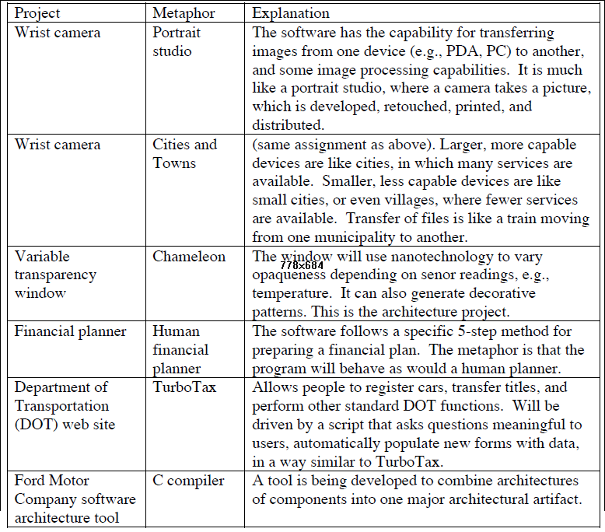
Example metaphors
XP
Source: Tomayko 03
.
sensor reading, e.g.

Slide 18
Refactoring
XP
Source: Fowler
“Disciplined technique for restructuring an existing body of code, altering its internal structure without changing its external behavior“
Example refactoring techniques:
Encapsulate attribute (field)into function
Replace conditional with dynamic binding
Extract routine (method)
Rename routine or attribute
Move routine or attribute to another class
Pull up, pull down
Used in agile methods as a substitute for upfront design

Slide 19
Part D: Practices 2: Development
What we have seen: Practices that have exerted significant influence on the way we develop software: pair programming, refactoring .. They are complements, not replacements, for more upfront-style techniques

Slide 20
Part D: agile practices
1: Meetings
2: Development
3: Release
4: Testing and quality
5: Management and others

Slide 21
Only one pair integrates code at a time
XP
Collective code ownership
Development proceeds in parallel
But: to avoid conflicts, only one pair is permitted to integrate its changes at any given time

Slide 22
Continuous integration
XP
The combination of frequent releases with relentless testing
Keep system fully integrated at all times

Slide 23
Continuous integration
XP
Source: Wake
Rather than weekly or daily builds, build system several times per day
Benefits:
Integration is easier because little has changed
Team learns more quickly
Unexpected interactions rooted out early: conflicts are found while team can still change approach
Problematic code more likely to be fixed because more eyes see it sooner
Duplication easier to eliminate because visible sooner

Slide 24
Release early and often
Follows from rejection of “Big Upfront Design”
Avoid long architectural phases
Refactor

Slide 25
Small releases
XP
Source: Jeffries
XP teams practice small releases in two important ways:
Release running, tested software, delivering business value chosen by the Customer, every iteration. The Customer can use this software for any purpose, whether evaluation or even release to end users.
Release to end users frequently as well. Web projects release as often as daily, in house projects monthly or more frequently. Even shrink-wrapped products are shipped as often as quarterly.

Slide 26
Incremental deployment
XP
Scrum
Deploy functionality gradually
“Big Bang” deployment is risky

Slide 27
Daily deployment
XP
Goes back to Microsoft’s Daily Build
“China Shop rules”: you break it, you fix it
Difficult to reconcile with other XP principles

Slide 28
Ten-minute build
XP
Source: Shore 08
“Make sure that the build can be completed, through an automatic script, in ten minutes or less, to allow frequent integration. Includes:
Compile source code
Run tests
Configure registry settings
Initialize database schemas
Set up web servers
Launch processes
Build installers
Deploy
Make sure the build provides a clear indication of success or failure”
“If it has to take more than ten minutes, split the project into subprojects, and replace end-to-end functional tests by unit tests”

Slide 29
Weekly cycle
XP
Source: Beck
Plan work a week at a time. Have a meeting at the beginning of every week:
1. Review progress, including how actual progress for the previous week matched expected progress
2. Have customers pick a week's worth of stories to implement this week
3. Break the stories into tasks
Start week by writing automated tests that will run when the stories are completed. Spend rest completing stories and getting tests to pass. The goal is to have deployable software at the end of the week. The nice thing about a week is that everyone is focused on having the tests run on Friday. If you get to Wednesday and it is clear that all the tests won't be running, you still have time to choose the most valuable stories and complete them.

Slide 30
Quarterly cycle
XP
Recommendation: reviews of high level system structure, goals and priorities on a quarterly basis, matching the financial reporting practices of many companies
Also an opportunity to reflect on the team practices and state of mind, and discuss any major changes in practices and tools
Period chosen as large enough not to interfere with current concerns, and short enough to allow frequent questioning of practices and updates of long-term goals

Slide 31
Part D: Practices 3: Release
What we have seen: Agile methods promote frequent release cycles and continuous integration Many variants (weekly, quarterly and in-between)

Slide 32
Part D: agile practices
1: Meetings
2: Development
3: Release
4: Testing and quality
5: Management and others

Slide 33
Coding standards
XP
Project members all code to the same conventions

Slide 34
All code must have unit tests
XP
Core idea of XP:
Do not write code without associated unit tests

Slide 35
All code must pass unit tests before moving on
XP
Code that does not pass tests is waste
Do not proceed to next step, e.g.
Next user story
Next release
until all tests pass

Slide 36
Test-First Development
Write tests before code
The test replaces the specification

Slide 37
Code the unit test first
XP
Source: Ron Jeffries
“Here is a really good way to develop new functionality:
1. Find out what you have to do.
2. Write a UnitTest for the desired new capability. Pick the smallest increment of new capability you can think of.
3. Run the UnitTest. If it succeeds, you're done; go to step 1, or if you are completely finished, go home.
4. Fix the immediate problem: maybe it's the fact that you didn't write the new method yet. Maybe the method doesn't quite work. Fix whatever it is. Go to step 3.
A key aspect of this process: don't try to implement two things at a time, don't try to fix two things at a time. Just do one.
When you get this right, development turns into a very pleasant cycle of testing, seeing a simple thing to fix, fixing it, testing, getting positive feedback all the way.
Guaranteed flow. And you go so fast!
Try it, you'll like it.”

Slide 38
Test-Driven Development
XP
Standard cycle:
Add a test
Run all tests and see if the new one fails
Write some code
Run the automated tests and see them succeed
Refactor code
Expected benefits:
Catch bugs early
Write more tests
Drive the design of the program
Replace specifications by tests
Use debugger less
More modular code
Better coverage
Improve overall productivity

Slide 39
Test-Driven Development
The basic idea is sound…
… but not the replacement of specifications by test
Major benefit: keep up-to-date collection of regression tests
Requirement that all tests pass can be unrealistic (tests degrade, a non-passing test can be a problem with the test and not with the software)
Basic TDD idea can be applied with specifications! See Contract-Driven Development

Slide 40
When bug found, create test before fixing it
XP
.
“A bug is not an error in logic, it is a test you forgot to write”

Slide 41
Root-cause analysis
XP
Scrum
When finding a defect, do not just fix it but analyze cause and make sure to correct that cause, not just the symptom

Slide 42
Run acceptance tests often and publish results
XP
Source: Wells
Acceptance tests are black box system tests. Each acceptance test represents some expected result from the system
Automate them so they can be run often
Publish acceptance test score is to the team

Slide 43
Part D: Practices 3: Testing and quality
What we have seen: Tests drive development Tests should all pass Tests replace specifications

Slide 44
Part D: agile practices
1: Meetings
2: Development
3: Release
4: Testing and quality
5: Management and others

Slide 45
Scrum of scrums
Scrum
Each day after daily scrum
Clusters of teams discuss areas of overlap and integration
A designated person from each team attends
Agenda as Daily Scrum, plus the following four questions:
What has your team done since we last met?
What will your team do before we meet again?
Is anything slowing your team down?
Are you about to put something in another team’s way?

Slide 46
Whole team
XP
Scrum
Source: Jeffries (abridged)
All contributors sit together as members of one team:
Includes a business representative who provides requirements, sets priorities and steers the project.
Includes programmers
May include testers
May include analysts, helping to define requirements
Often includes a coach
May include a manager
None of these roles is the exclusive property of just one individual. The best teams have no specialists, only general contributors with special skills

Slide 47
Planning poker
Scrum
Present individual stories for estimation
Discuss
Deck has successive numbers (quasi-Fibonacci)
Each participant chooses estimate from his deck
Keep estimates private until everyone has chosen a card
Reveal estimates
Repeat until consensus
(Variant of Wideband Delphi technique.)

Slide 48
Open workspace
XP
Crystal
Workspace:
Organized around pairing stations
With whiteboard space
Locating people according to conversations they should overhear
With room for personal effects
With a place for private conversations
Expected benefits: improve communication, resolve problems quickly with the benefits of face-to-face interaction (as opposed to e.g. email)

Slide 49
Osmotic communication
Crystal
Team is together in a room and listen to each other
Information to flow around it
Developer must break concentration
Information flows quickly throughout the team
Questions answered rapidly
All team updated on what is happening
Reduce need for email and other non-direct communication
Facilitate taking over of others’ tasks

Slide 50
Informative workspace
XP
Scrum
Facilitate communication through well-organized workspace:
Story board with user story cards movable from not started to in progress to done column
Release charts
Iteration burndown charts
Automated indicators showing the status of the latest unit-testing run
Meeting room with visible charts, whiteboards and flipcharts

Slide 51
Technical environment
Crystal
Access to automated tests, configuration management, frequent integration, code repository

Slide 52
Team continuity
XP
Keep the team together and stable
Do not reassign people to other teams or treat them as mere resources

Slide 53
Shrinking teams
XP
Source: Beck 05
As a team grows in capability, keep its workload constant but gradually reduce its size
This frees people to form more teams
When the team has too few members, merge it with another too-small team

Slide 54
Code and tests
XP
Maintain only code and tests as permanent artifacts

Slide 55
Customer always available
XP
Source: Wells
All project phases require communication with customer, preferably face to face. Assign one or more customers to the development team who:
Help write user stories to allow time estimates & assign priority
Help make sure most of the desired functionality is covered by stories
During planning meeting, negotiate selection of user stories for release
Negotiate release timing
Make decisions that affect their business goals
Try system early to provide feedback
(etc.)
“This may seem like a lot of the customer's time but the customer's time is saved initially by not requiring a detailed requirements specification and later by not delivering an uncooperative system”

Slide 56
Code and tests
XP
Maintain only code and tests as permanent artifacts

Slide 57
Slack
XP
Source: Beck, deMarco
“In any plan, include some minor tasks that can be dropped if you get behind.”
Goals:
Establish trust in the team's ability to deliver
Reduce waste

Slide 58
Part D: Practices 5: Management and others
What we have seen: A number of management practices supporting the agile principles, in particular by ensuring that management gives developers the support and comfort they need

